Slide 1
Solar Charger
Chrisner Garcesa
Engr 460

Slide 2
Project Description
Build a device to lower solar panel voltage
Initially thought of connecting solar panel directly to phone
Possible damage
Considered using a voltage regulator before using buck boost converter
Solar Panel
Buck Boost Converter
Phone

Slide 3
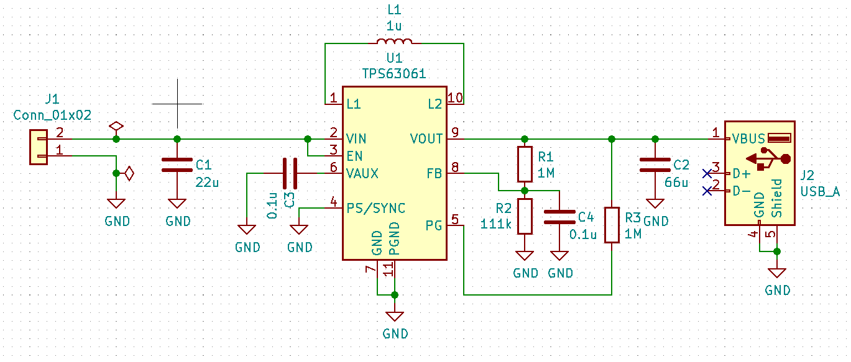
Initial Schematic

Slide 4

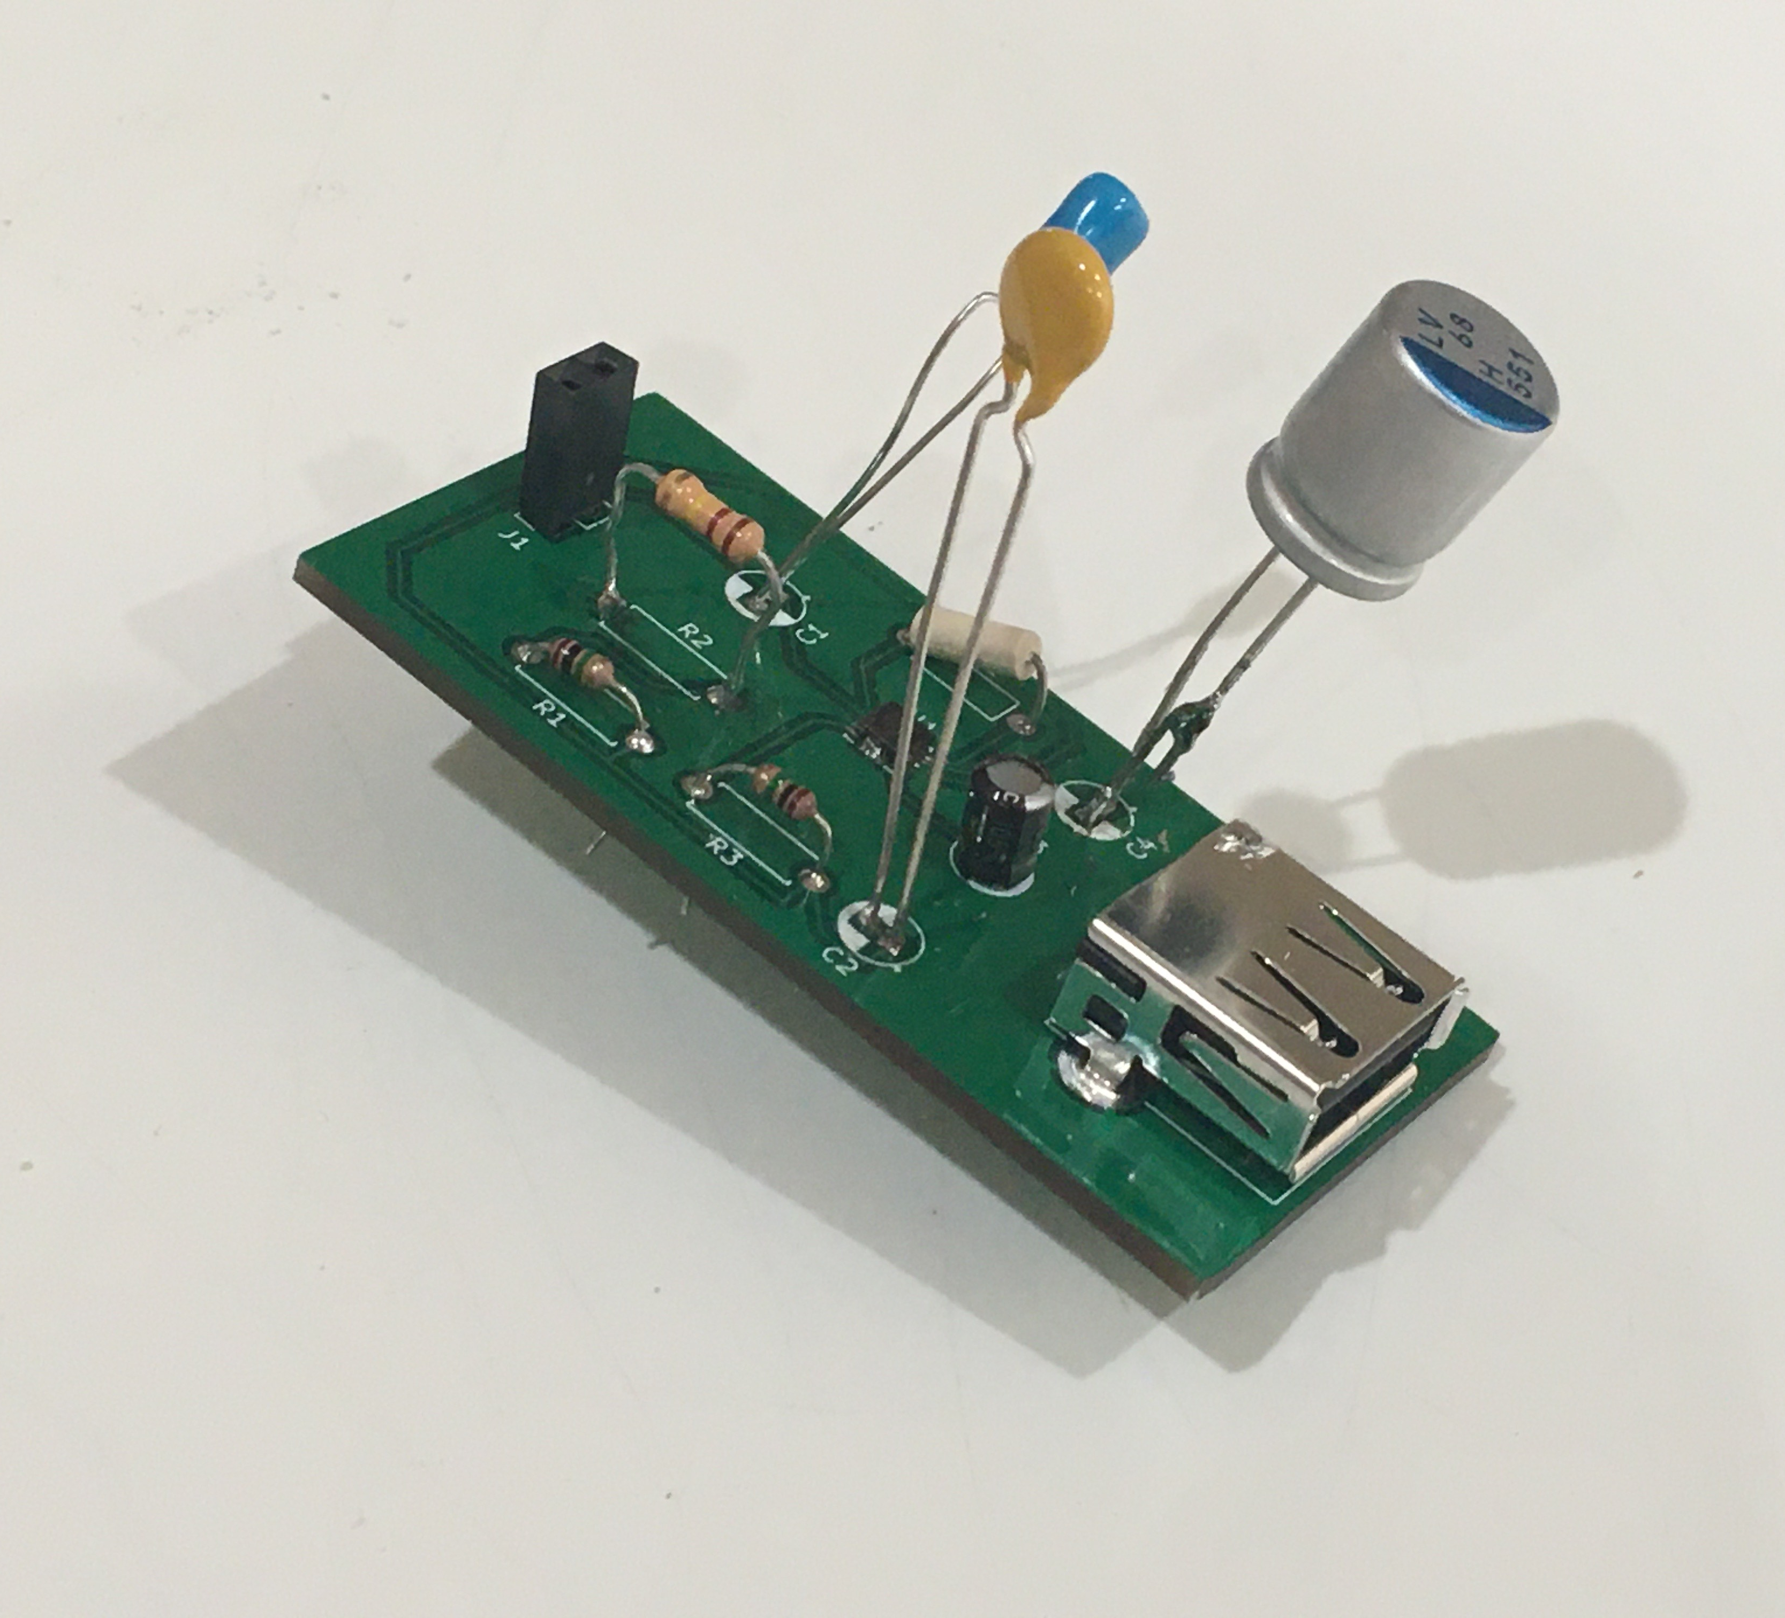
Test Results
Did tests at noon; didn’t work out the first time
Tested for voltage at the USB port
Did some simulations
Voltage didn’t come up all the way to 5 V (more around 4.5 ~ 4.7 V) w/ initial schematic

Slide 5
Possible Fixes?
Change one of the capacitor values
Had misread the capacitor values when I read the data sheet
Caused it not reach up to 5 V
Reconfigure the circuit to accommodate for slightly lower voltages
Noticed that voltage would not reach 5 V in simulation if input voltage was not above 6 V

Slide 6





Questions Pls no

